Slide 1
“Analytics enabled Marketing strategy to predict most probable buyers with objective of optimizing the profitability ”
Presented by: Parixitsinh V Chudasama
Under the guidance of: Pranab Das

Slide 2
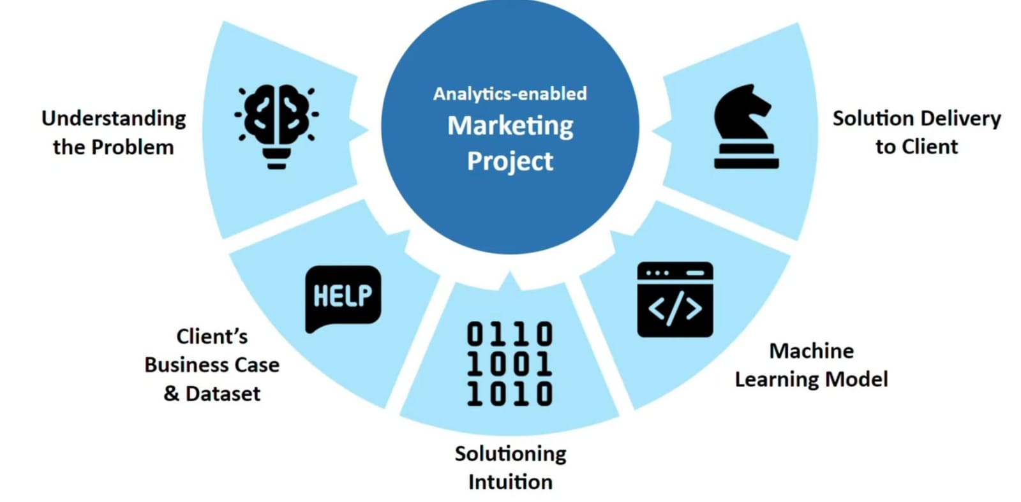
Analytics enabled Marketing

Slide 3
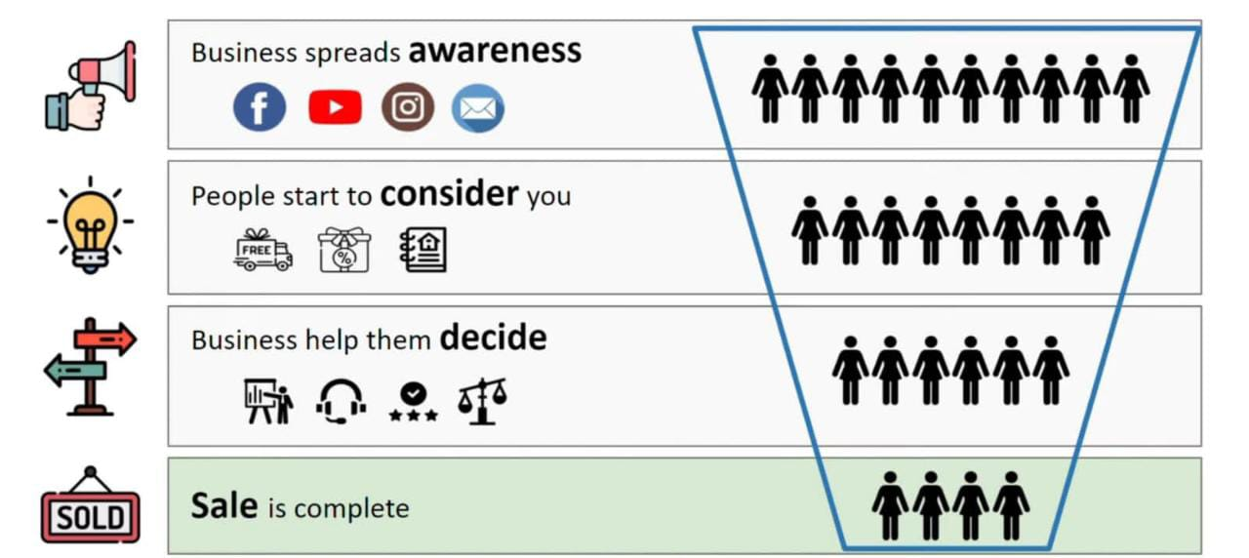
Marketing Funnel

Slide 4
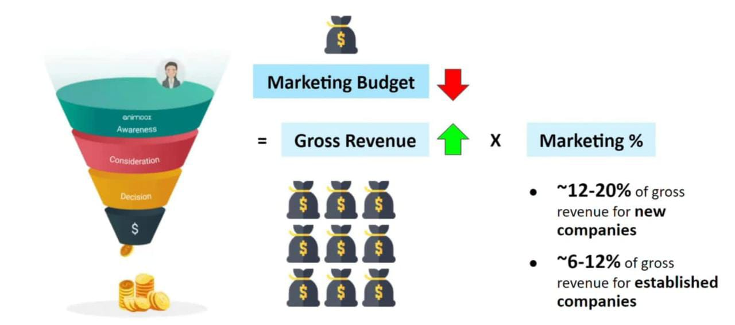
Marketing Budget

Slide 5
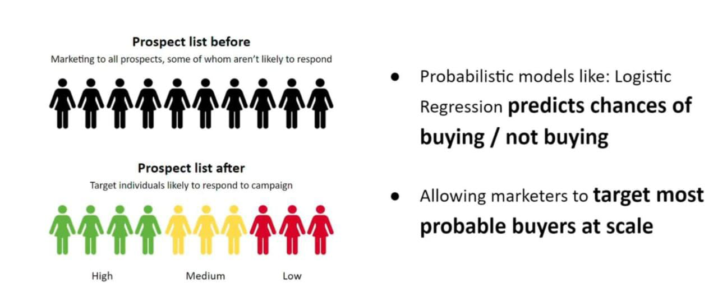
Solutioning Intuition

Slide 6
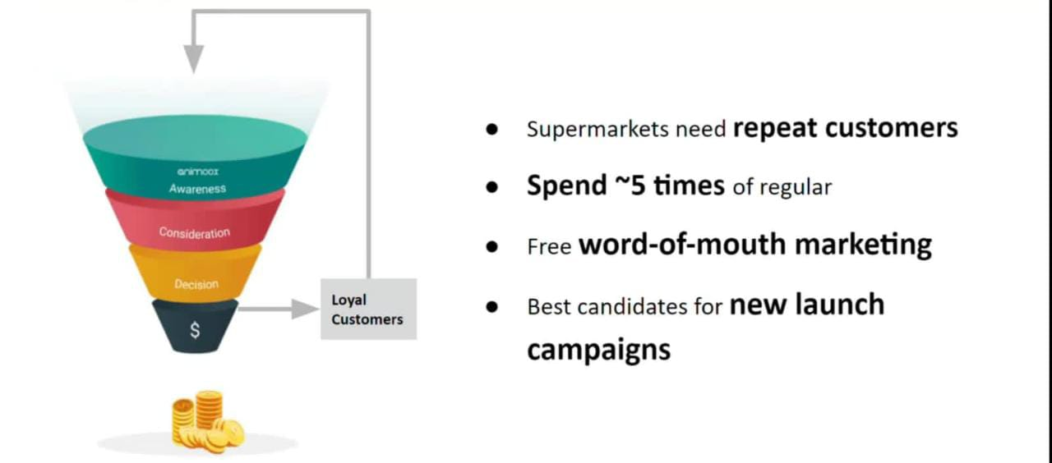
Client Introduction
Our Client is Walmart which is a Supermarket. It is a major retail player running in UK with multiple stores.
As our client is seeing their loyalty program participants as the majority company target audience we shall understand the importance of loyalty programs.
All retail businesses maintain data for their loyal customers , they are the best candidates for analytics based marketing campaign

Slide 7
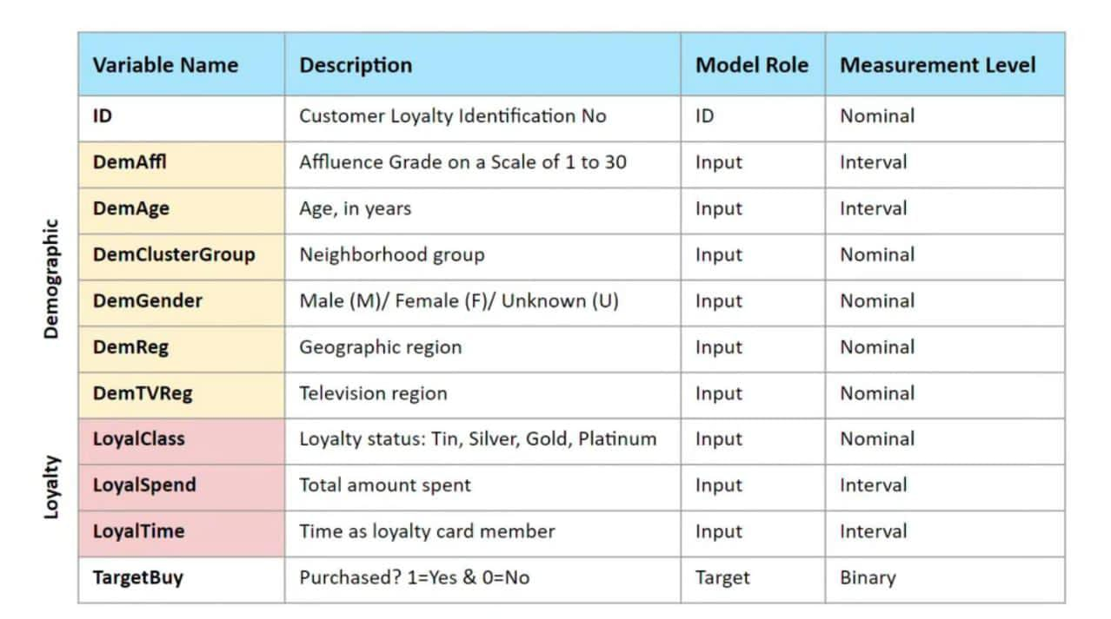
Description of our Dataset

Slide 8
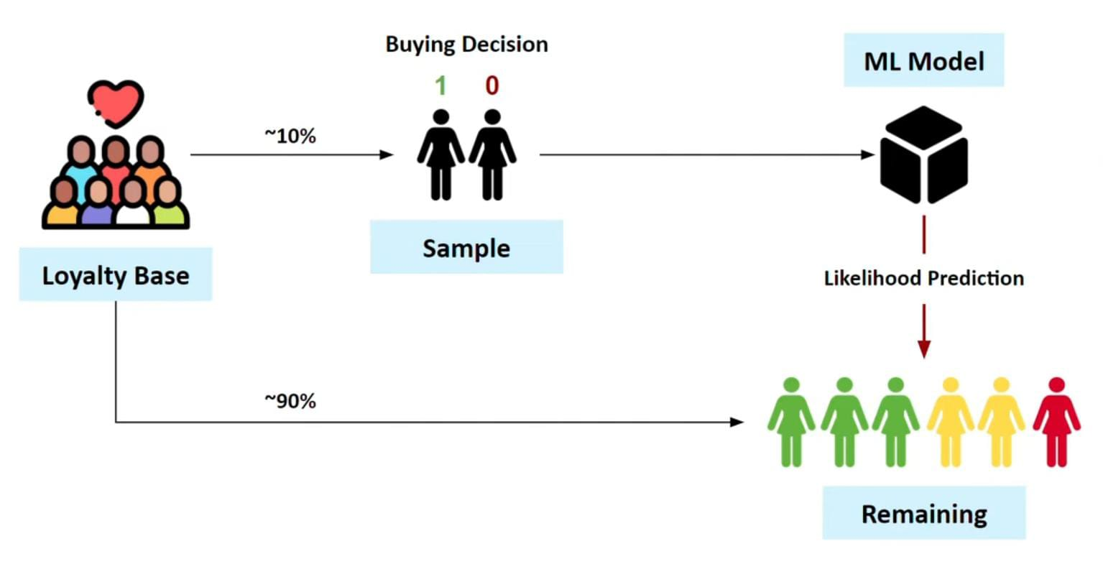
Solution Architecture

Slide 9
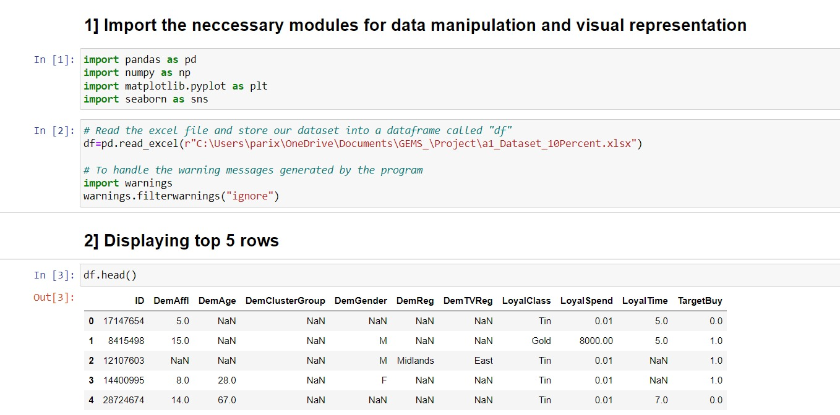

Slide 10
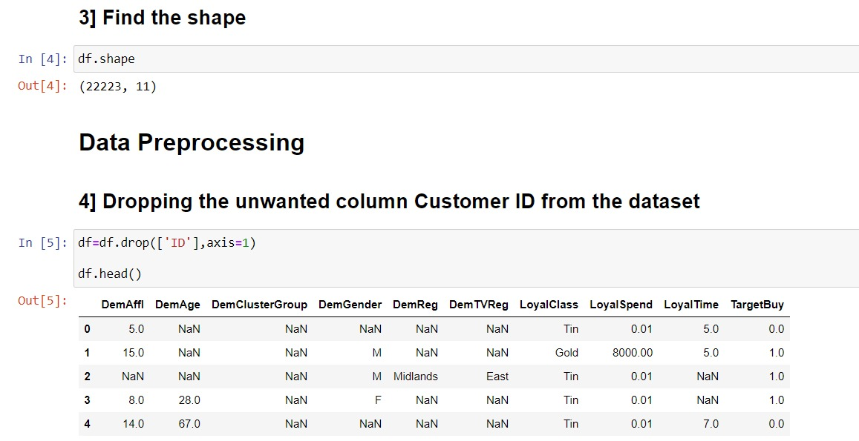

Slide 11
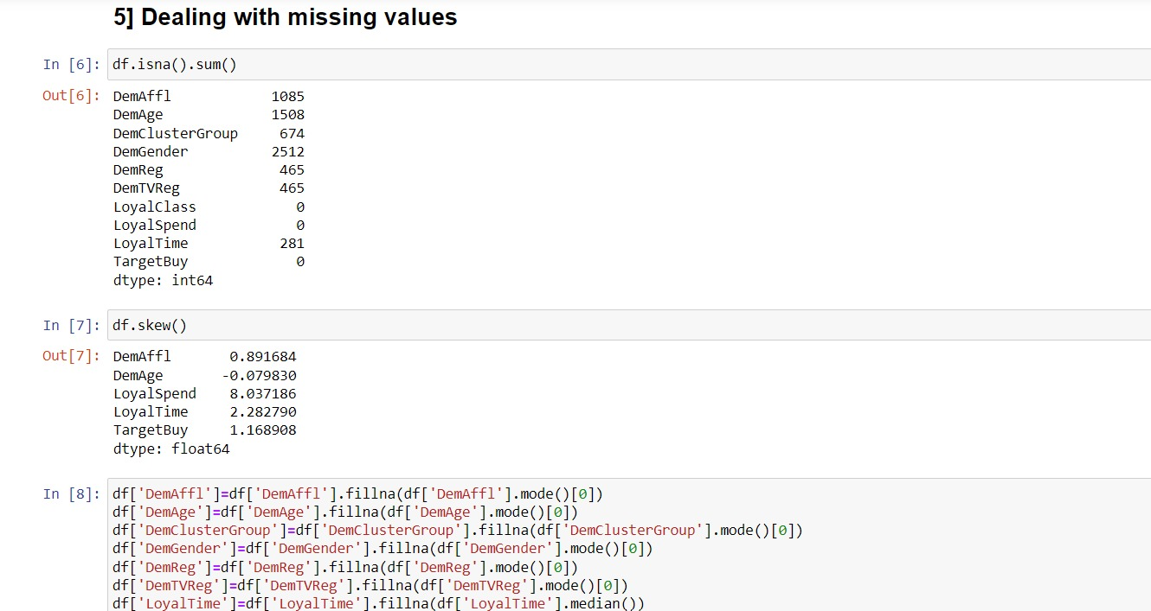

Slide 12
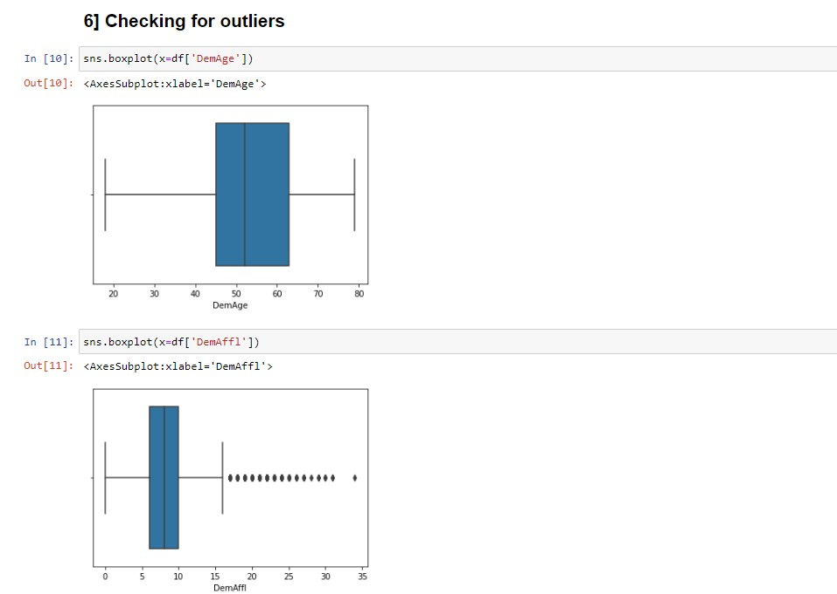
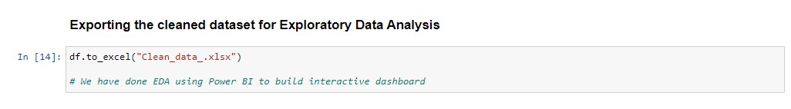

Slide 13
Exploratory Data Analysis
Customer Segmentation and Demographic Analysis: Explore demographic attributes such as age, gender, and regional distribution to segment customers. Understand how different demographic clusters vary in terms of loyalty class, spending behaviour, and time spent as customers. Identify any dominant demographic trends among loyal customers.
Loyalty Class and Spending Impact on Purchase: Investigate the impact of loyalty class on customer purchasing behaviour. Analyse whether customers with higher loyalty class levels tend to make more purchases. Study the relationship between loyal spending and the likelihood of making a purchase.
Age and Gender Influence on Purchase Behaviour: Examine how customer age and gender relate to their purchase decisions. Determine whether specific age groups or genders are more likely to make purchases. Identify any correlations between age, gender, and the tendency to buy.

Slide 14
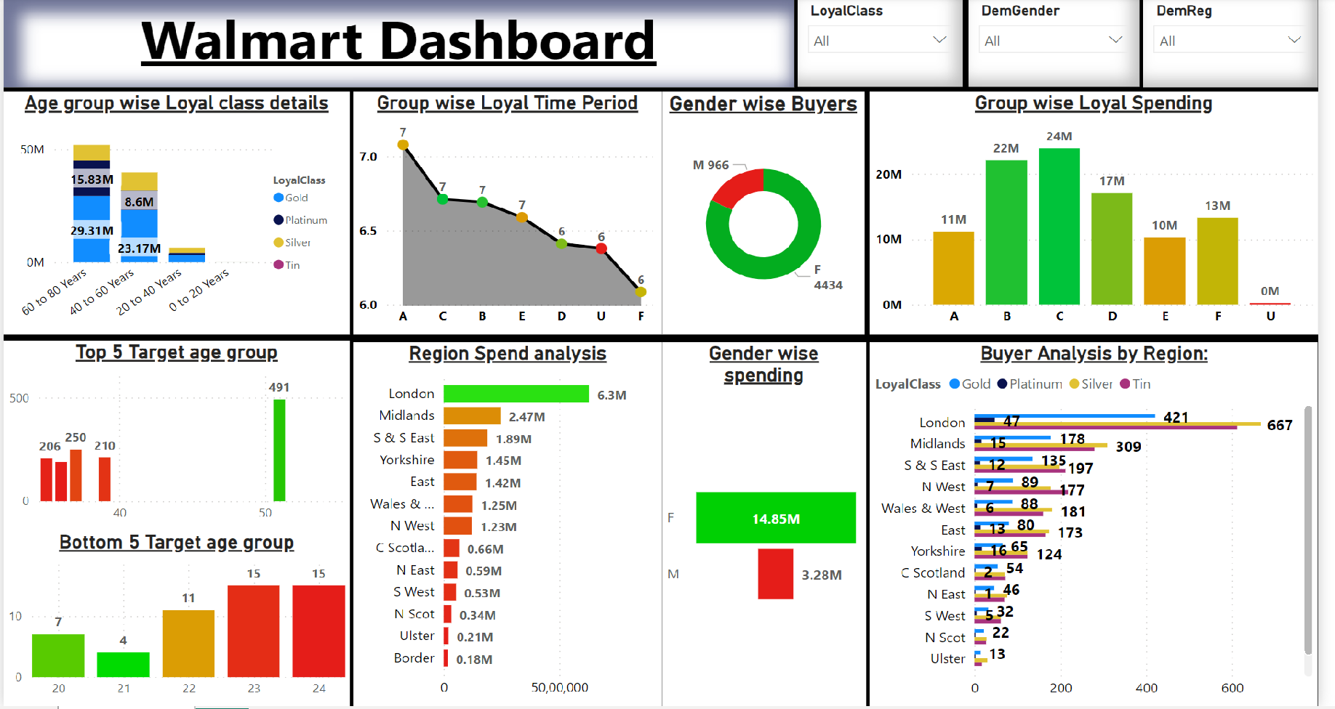

Slide 15
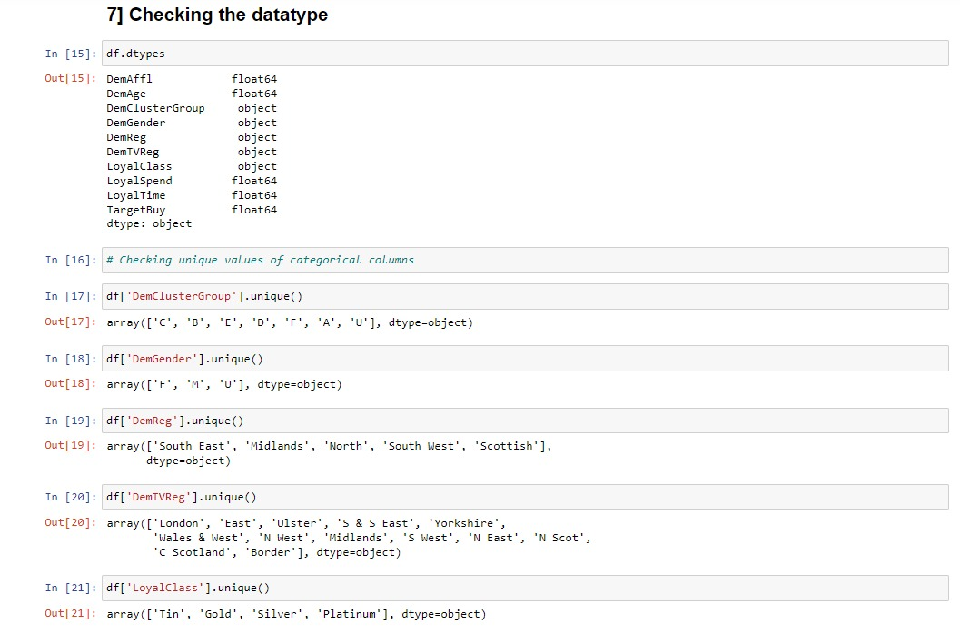

Slide 16
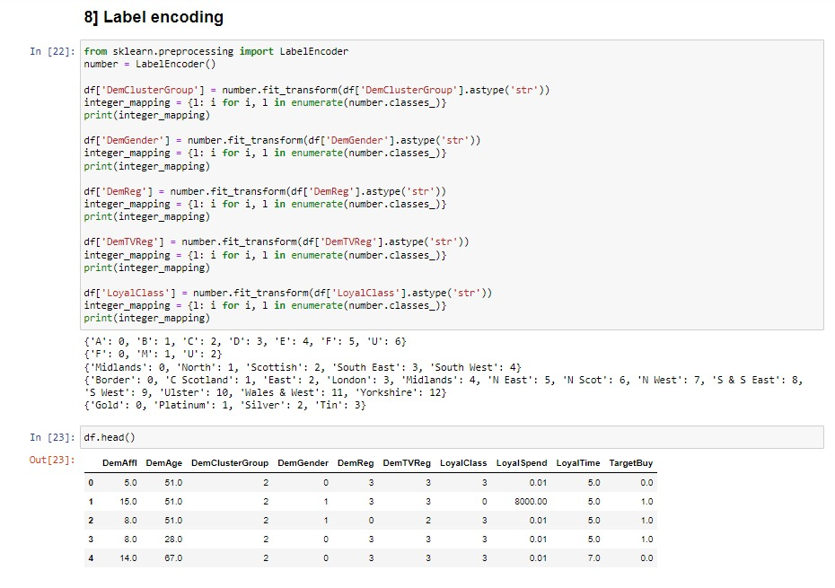

Slide 17
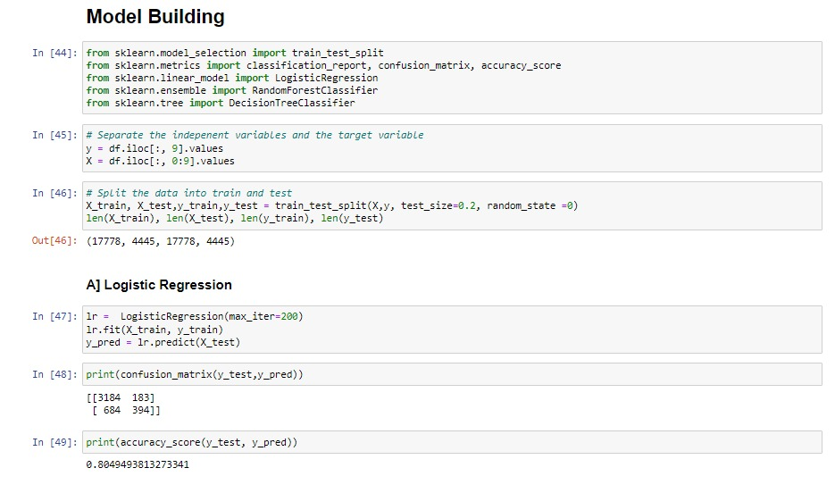

Slide 18
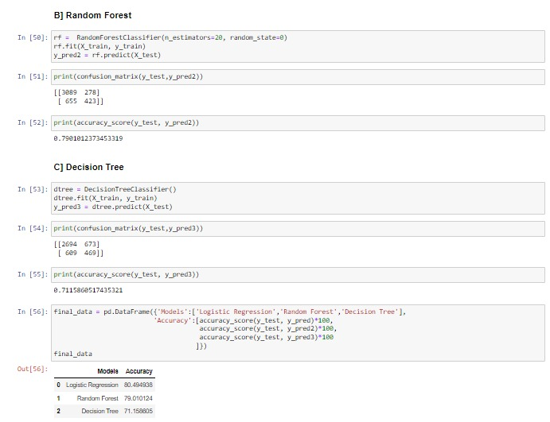

Slide 19
Deciding on Model
As it is a supervised classification problem where predict variable is “Target Buy" is a binary variable, here we will use Logistic regression model to find the probability score of the most probable buyers.
The accuracy of the model we are going to reach is 75% to 80%.
We will try to improve the accuracy by building more advanced models like SVM, XGBoost etc.

Slide 20
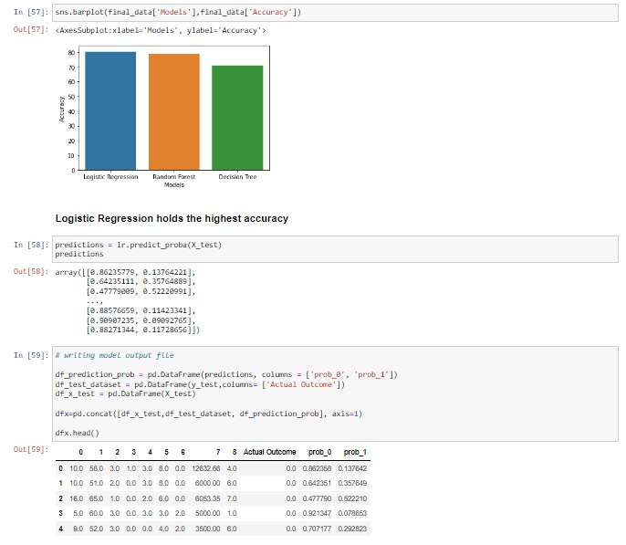

Slide 21
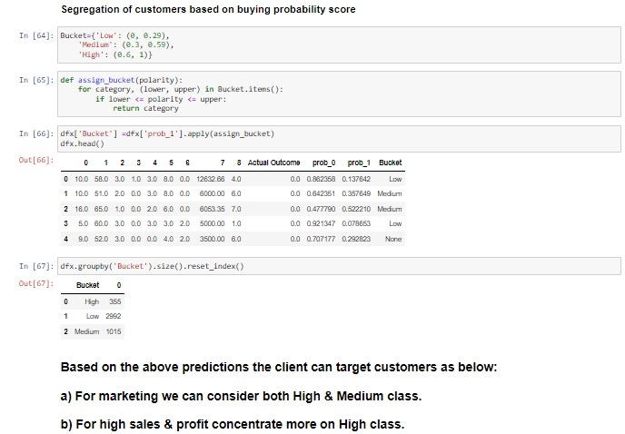

Slide 22
Conclusion And Future Scope
Based on the model predictions the client can target customers as below:
a) For marketing we can consider both High & Medium class.
b) For high sales & profit concentrate more on High class.
We can further implement Sentiment analysis on customer feedbacks to high , low & medium buckets by sending out customized feedback forms . Based on this initiation we can understand and convert people from lower bucket to higher bucket.

Slide 23
THANK YOU

